Slide 1
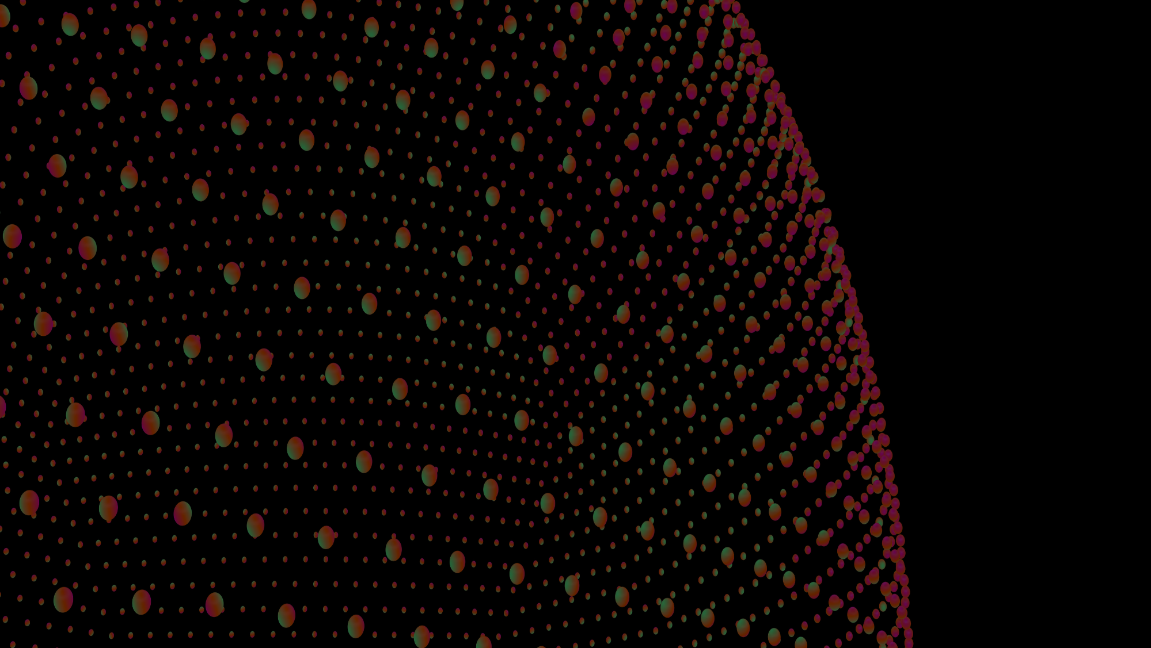
Morphing of facial 3D mesh
Baha Mabrouk

Slide 2
Objective
Extracting 3D pointcloud from 2D image
Morphing two point cloud representation of facial features from one face to another

Slide 3

Process
Extract facial features out of a 2D image
Represent it in a points distrubution
Recreating depth and transforming the 2D point mesh into a 3D point cloud
Morphing two point cloud representation of facial features from face to another

Slide 4
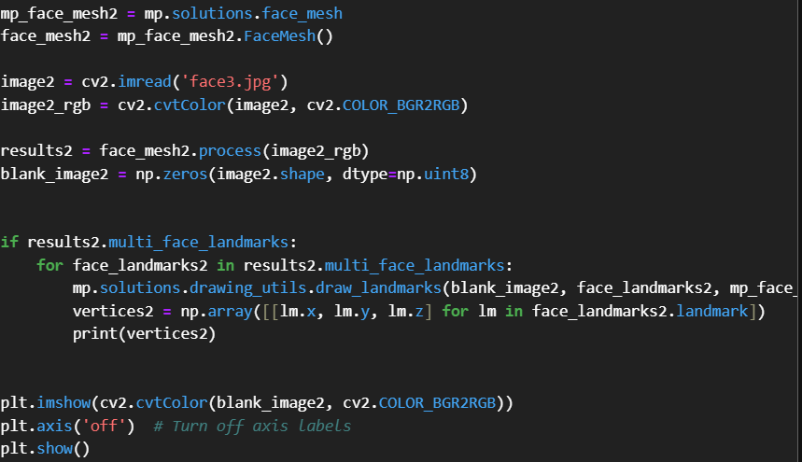
Feature Extraction from 2d image
MEDIAPIPE from GOOGLE
https://developers.google.com/mediapipe/solutions/vision/face_landmarker
The MediaPipe Face Landmarker task lets you detect face landmarks and facial expressions in images and videos. You can use this task to identify human facial expressions, apply facial filters and effects, and create virtual avatars.

Slide 5

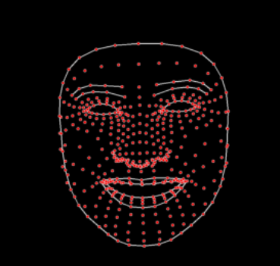
Extracting facial features out of 2d Image
Original Image
Mesh of features

Slide 6
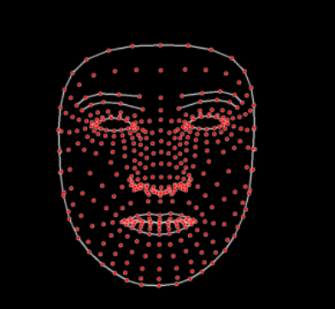

Extracting facial features out of 2d Image
Original image 2
Mesh of features 2

Slide 7
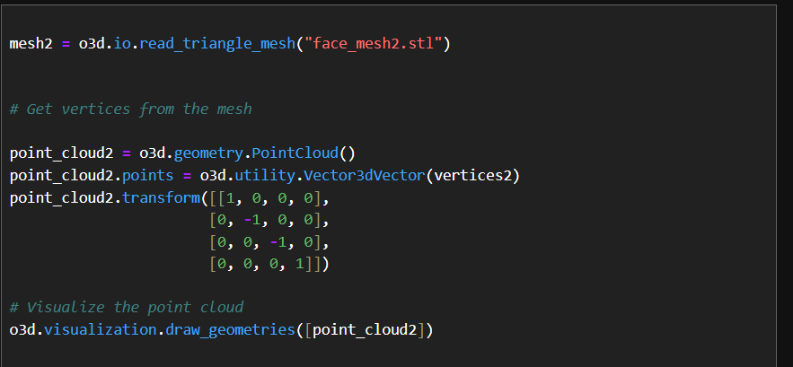
Point cloud extraction
To extract a point cloud from a 2D mesh using Open3D, we used the create_point_cloud_from_depth_image function along with a depth image generated from your mesh.

Slide 8
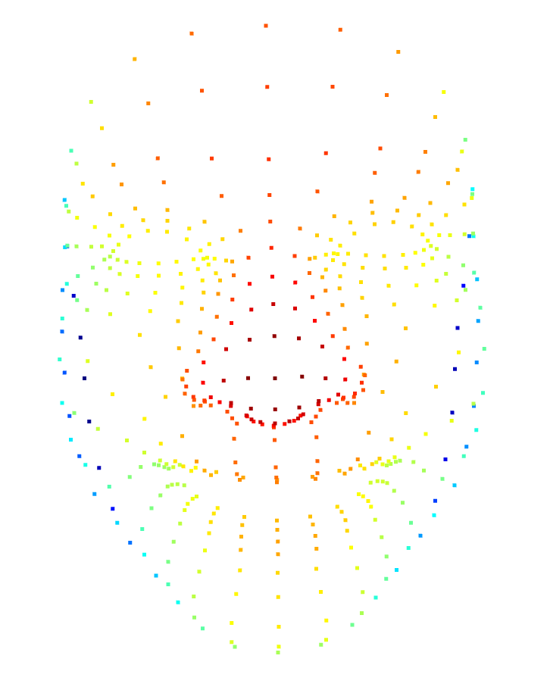

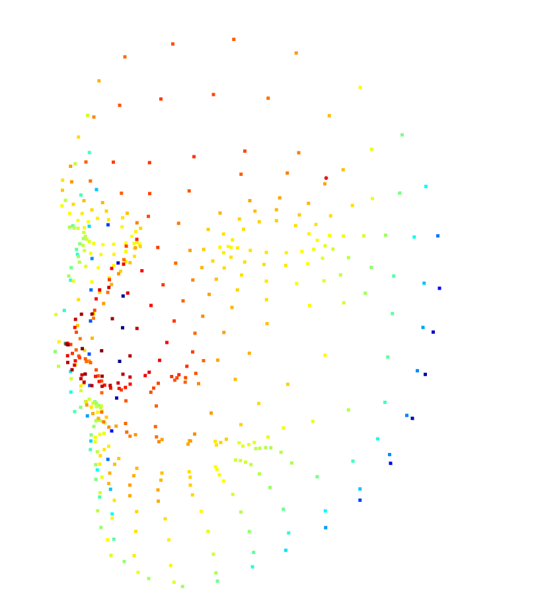
Creating 3d Point Cloud

Slide 9
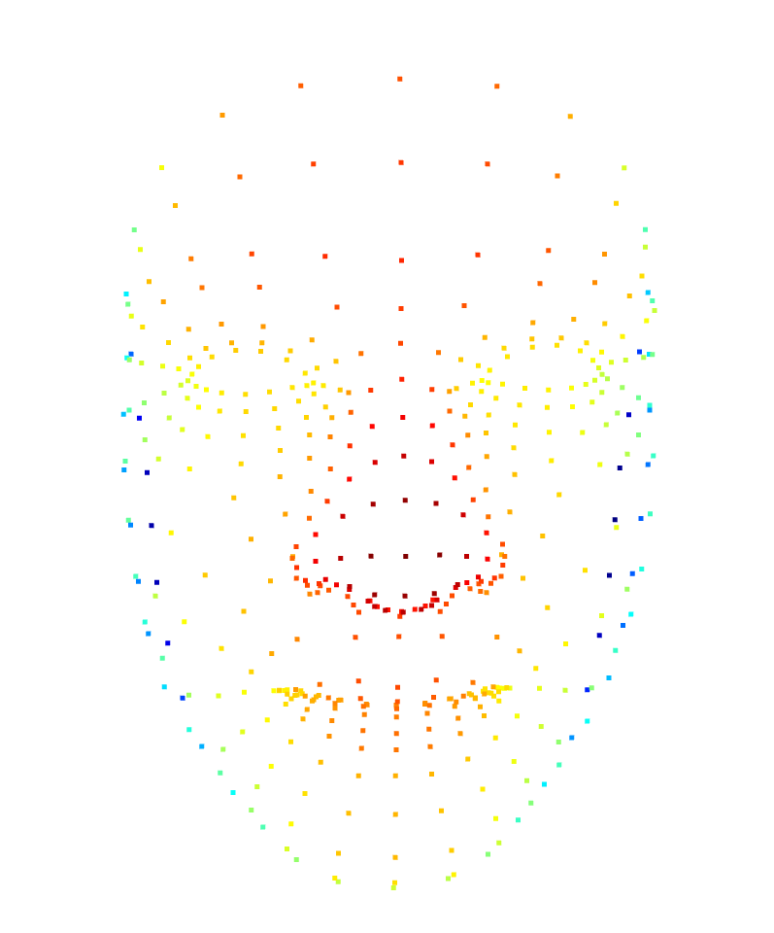
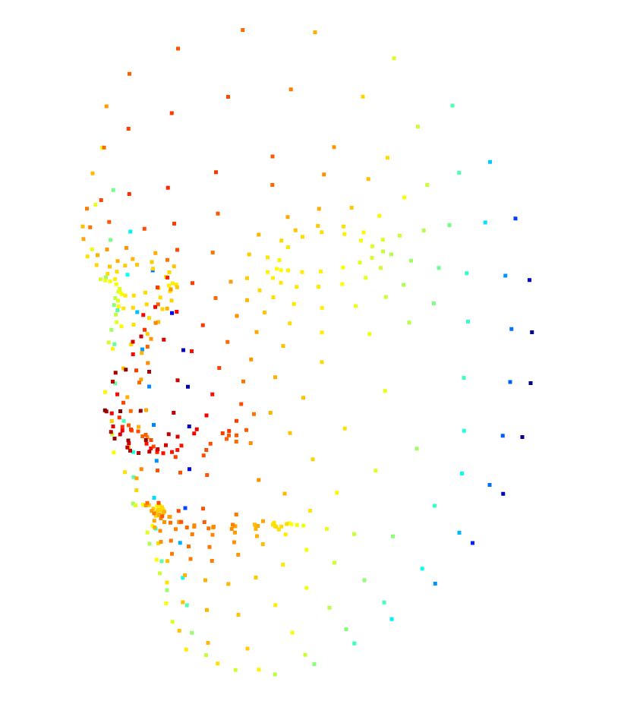
Creating 3d Point Cloud

Slide 10
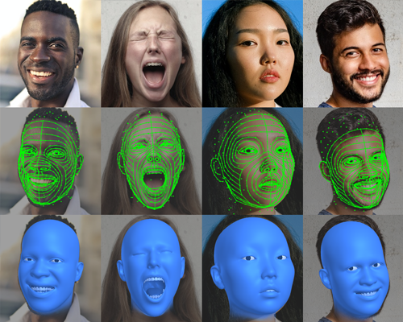
Additional Perspectives
Microsoft’s 3D Face Reconstruction with Dense Landmarks library
Which would allow us to reconstruct or to generate a 3D model from the point cloud

